Slide 1
Lec#4
Information Technology Infrastructure Library (ITIL)

Slide 2
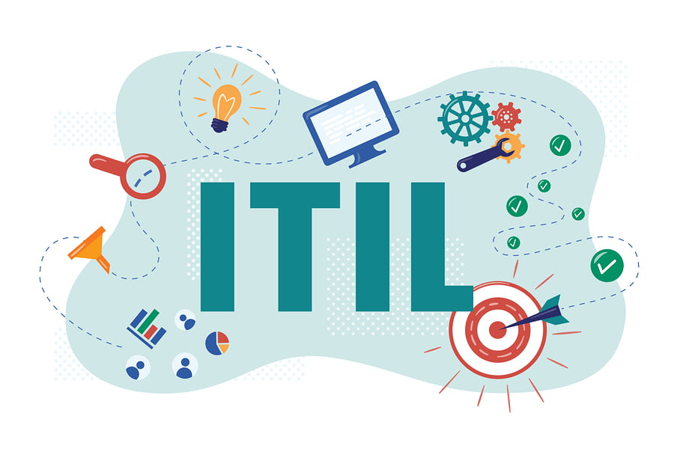
The ITIL (Information Technology Infrastructure Library) is a framework designed to standardize the selection, planning, delivery, maintenance, and overall lifecycle of IT (information technology) services within a business.

Slide 3
ITIL is a library of best practices for managing IT services and improving IT support and service levels. One of the main goals of ITIL is to ensure that IT services align with business objectives, even as business objectives change.
The ITIL framework enables IT administrators to be business service partners, rather than just back-end support. ITIL guidelines and best practices align IT department actions and expenses to business needs and change them as the business grows or shifts direction.

Slide 4
One of the most essential parts of ITIL is the configuration management database (CMDB), which provides the central authority for all components—including services, software, IT components, documents, users, and hardware—that must be managed to deliver an IT service. The CMDB tracks the location of, and changes to, all of these assets and processes, along with their attributes and relationships to each other.

Slide 5
ITIL process framework

Slide 6
ITIL v3's stages and processes
Service Strategy
Describes business goals and customer requirements and how to align objectives of both entities. It includes the following processes:
Strategy Management for IT Services
Service Portfolio Management
Financial Management for IT Services
Demand Management
Business Relationship Management

Slide 7
2. Service Design
Outlines practices for the production of IT policies, architectures and documentation. Processes include the following:
Service Catalog Management
Availability Management
Information Security Management
Service Level Management
Capacity Management
Design Coordination
Supplier Management
IT Service Continuity Management

Slide 8
3. Service Transition
Advises on change management and release practices, and also guides admins through environmental interruptions and changes. It includes the following processes:
Transition Planning and Support
Change Management
Change Evaluation
Release and Deployment Management
Service Asset and Configuration Management
Service Validation and Testing
Knowledge Management:

Slide 9
4. Service Operation
Offers ways to manage IT services on a daily, monthly and yearly basis. It includes the following processes:
Access Management
Event Management
Service Request Fulfillment
Incident Management
Problem Management:

Slide 10
5. Continual Service Improvement
Covers how to introduce improvements and policy updates within the ITIL process framework.

Slide 11
ITIL v4 presents four dimensions of service management:
organizations and people;
value streams and processes;
information and technology;
partners and suppliers.
These are mapped to service value systems and chains.

Slide 12
ITIL v4 also includes the practices, defined as resources and activities to perform work or accomplish an objective. These practices are broken down into three categories:
General management practices
Service management practices
Technical management practices

Slide 13
Benefits and drawbacks of ITIL
Benefits of ITIL certification:
Better goal alignment between IT departments and the business
Improved service timelines and customer satisfaction
Reduced operational costs due to better utilization of resources -- digital, physical and human
Increased visibility of IT costs and assets
Streamlined service disruption response and management
More flexible service environment that can easily adapt to change

Slide 14
ITIL drawbacks:
Training requirements can be extensive and time-consuming, and successful implementation requires staff expertise
ITIL rollouts can take years to fully implement and refine
There is little, if any, short-term return on ITIL initiatives
Changes prescribed by ITIL initiatives can be disruptive to existing process and infrastructure
The long-term nature of ITIL can easily be disrupted by other short-term projects and initiatives

Slide 15
Conclusion
ITIL will continue to help organizations ensure that they are supporting the best processes for their environment. As the underlying capabilities of businesses continue to change rapidly, ITIL processes should change with them. For example, an ITIL Change Approval Board (CAB), which typically reviews whether changes should go into production, may have to adapt to the speed of change by adapting to a policy-driven approval process.

